Slide 1
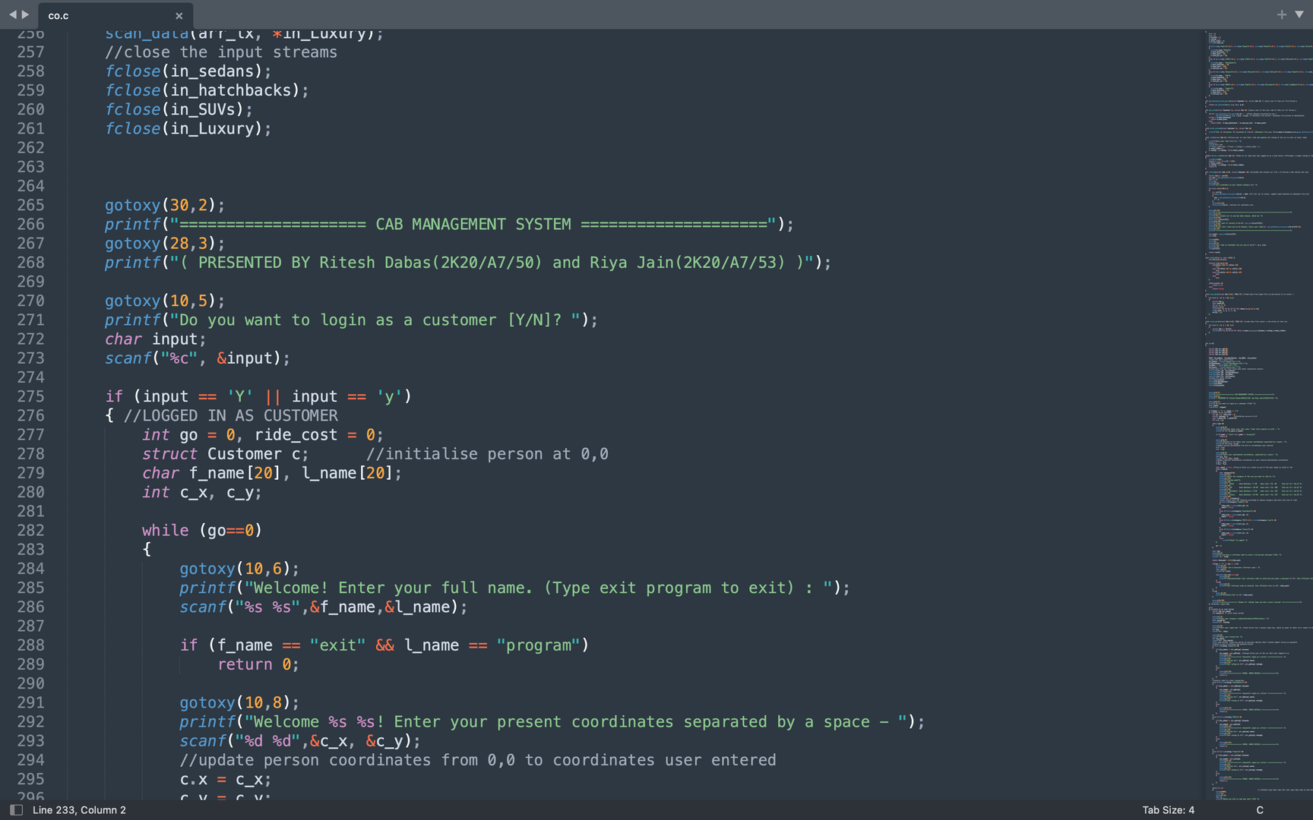
CO 102 MTE PROJECT
CAB MANAGEMENT SYSTEM
Presented by
Ritesh Dabas 2K20/A7/50
Riya Jain 2K20/A7/53
Submitted to
Ms. Gull Kaur

Slide 2
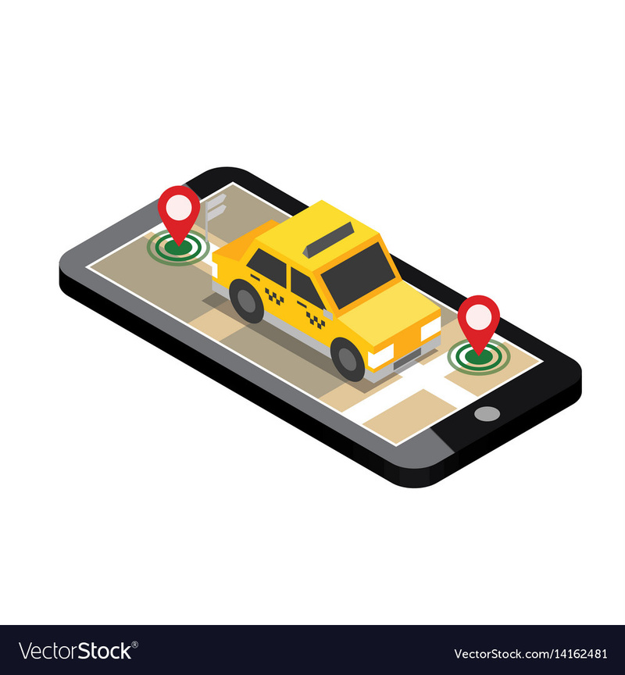
Objective
Through this project we aimed to devise a handy and easy to use cab management system using the C programming language. We incorporated the basic features of a cab service into the program to make it as user friendly as possible.
The customer may book a cab according to their liking, rate their ride and avail a discount.
The driver can login to get a new ride and at the end of the day, learn their total earnings.

Slide 3
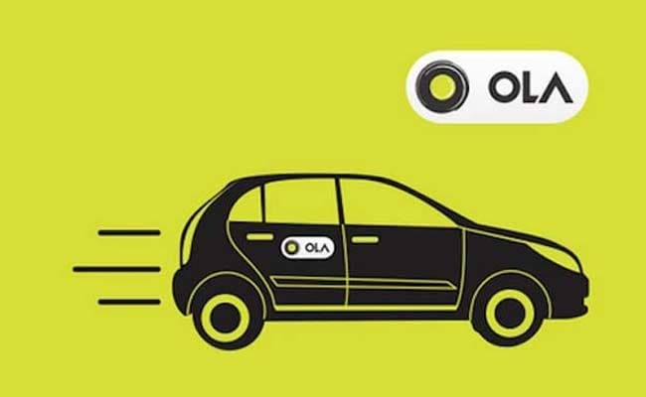
Motivation
In our daily lives, we all have come across a situation where we might need to book a cab so we resort to the apps on our phones like UBER, OLA, LYFT etc.
So taking inspiration from that, we tried to develop a cab management system. We mapped out how the program works and how to go about the procedure to devise a system which works in the same way. We gathered some ideas and implemented them in the best way possible with the resources given

Slide 4
Introduction
In this cab management system, the user may login as a customer or a driver and then proceed according to the flow of system.
The customer will input their coordinates and their choice of cab which then yields the probable output. They are allotted the nearest cab depending on their coordinates.
Once the ride ends, they are displayed the amount which they can avail a discount upon if their reference code is valid. They also rate the driver at the end.
The driver on logging in can see their rating and the amount they earned and also get coordinates for a new customer to drive to their destination.
At the end of the ride the driver is rated, which affects their average rating, and the earning is added in the total amount.
This system depicts the basic functioning of any cab management system.

Slide 5
Implementation Details
We used the code editor Sublime Text to write, edit and implement our code
The coding language being C, we primarily made use of structs, functions and arrays to create our program
We used file handling to extract information from files stored on the system
While the program is being run, input is taken at various stages to customize the output

Slide 6
Key Features
HEADER FILES USED
FUNCTIONS CREATED
OUTPUT FORMATING FUNCTIONS
#include <stdio.h>
#include <conio.h>
#include <stdlib.h>
#include <string.h>
#include <time.h>
#include <windows.h>
#include <ctype.h>
customer
prior
get_distance
cab
get_distance_from_person
get_cost
rate
driver_rate
journey
isValid
gotoxy()
clrscr()
sleep()
FUNCTIONS FOR FILE HANDLING
STRUCTURES CREATED
scan_data
print_data
Customer
Cab

Slide 7
File Handling
File handling in C refers to the task of storing data in the form of input or output produced by running C programs in data files, namely, a text file or a binary file for future reference and analysis.
We also made use of file handling in our project to approach the text files on the system so that we can maintain some details in the form of text files that are accessed at runtime.
Some operations we used in data handling:
Opening an existing file (fopen with attributes as “r” or “r+” or “w” or “w++”)
Reading from file (fscanf or fgets)
Writing to a file (fprintf or fputs)
Moving to a specific location in a file (fseek, rewind)
Closing a file (fclose)

Slide 8
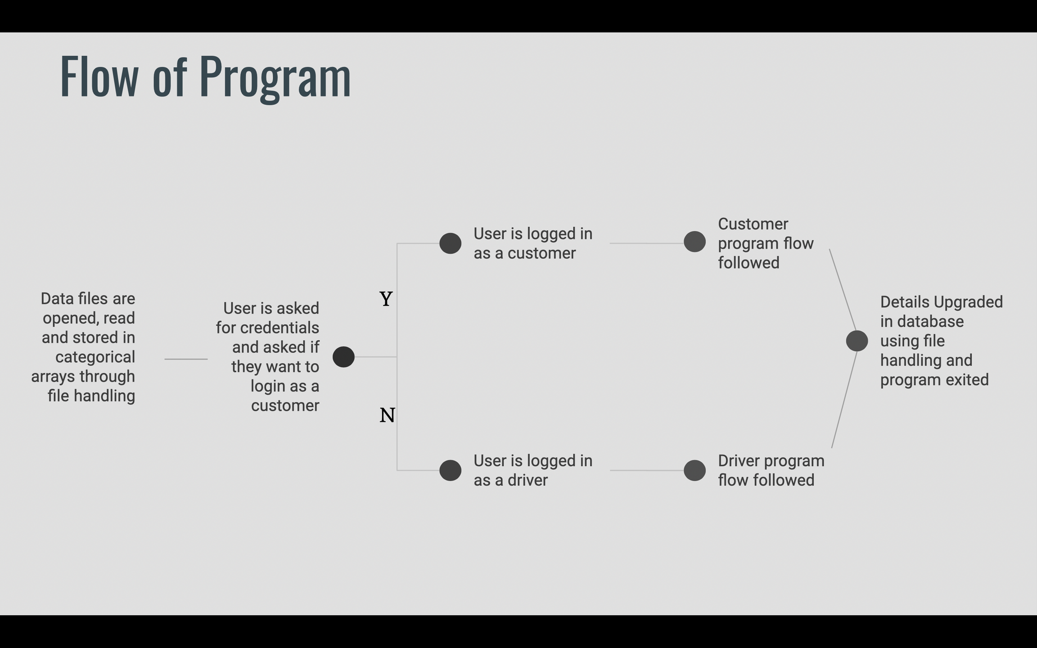

Slide 9
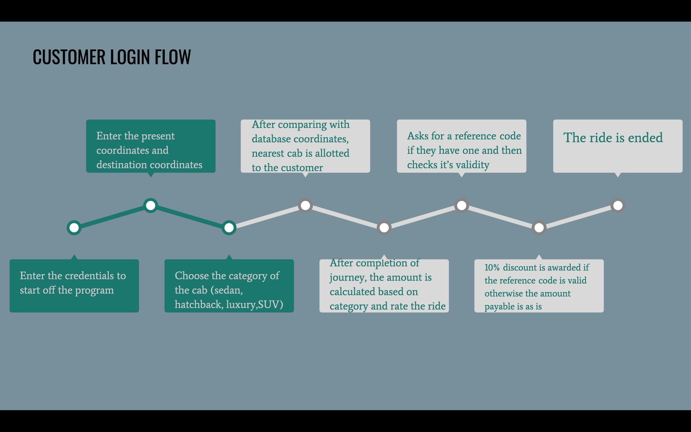

Slide 10
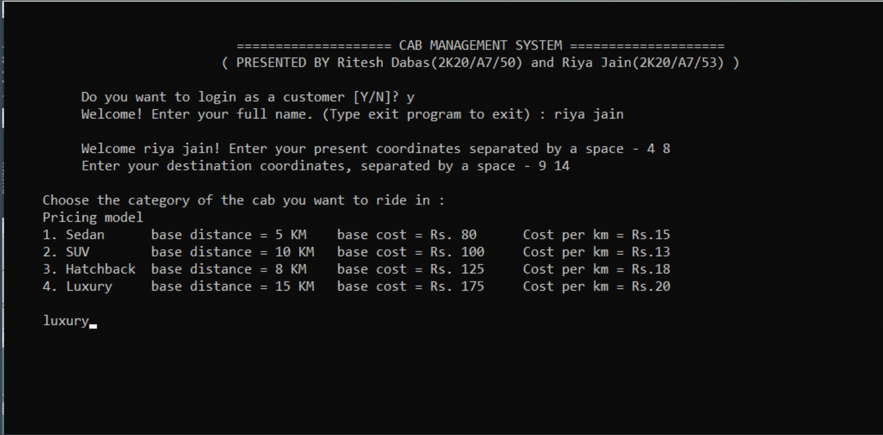
Logged in as a customer and input credentials, coordinates & category

Slide 11
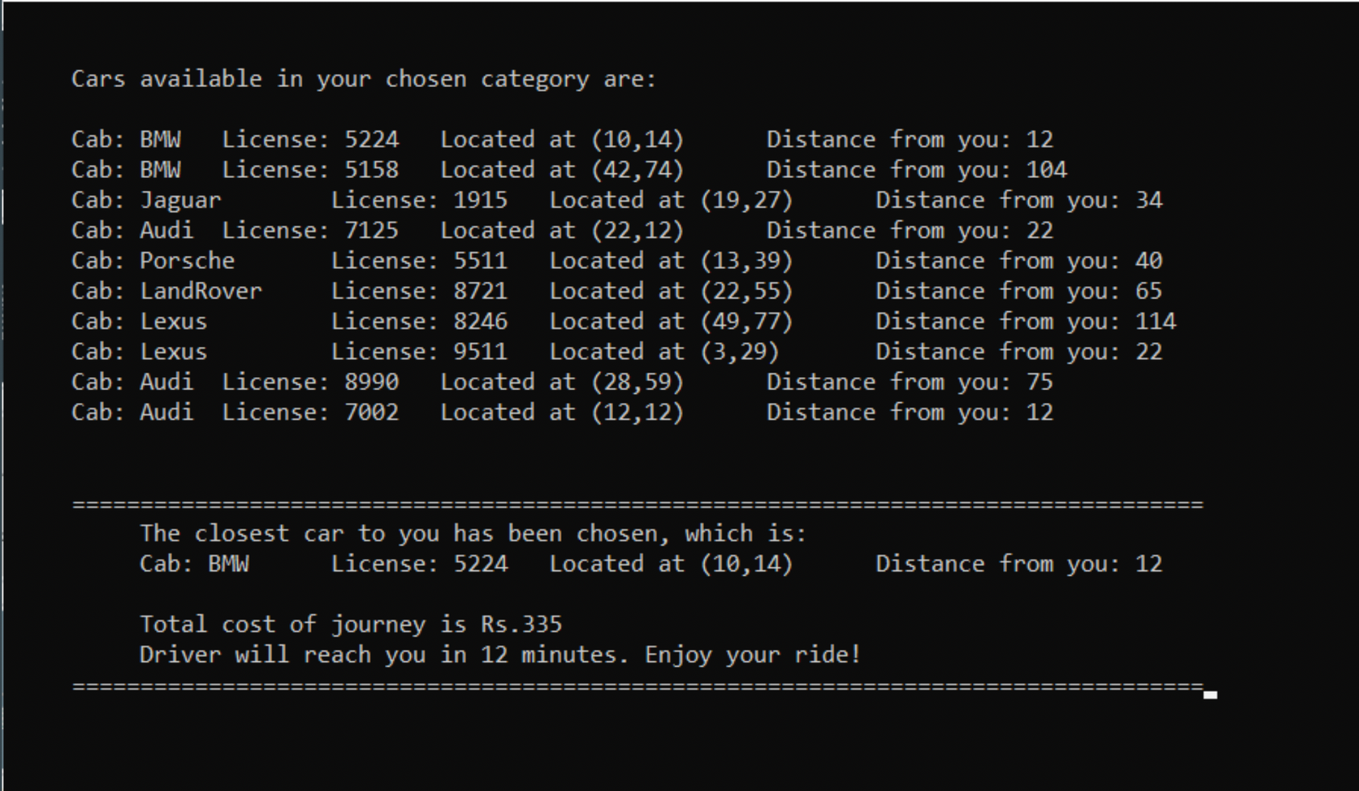
Shows available cabs and chooses the nearest one

Slide 12
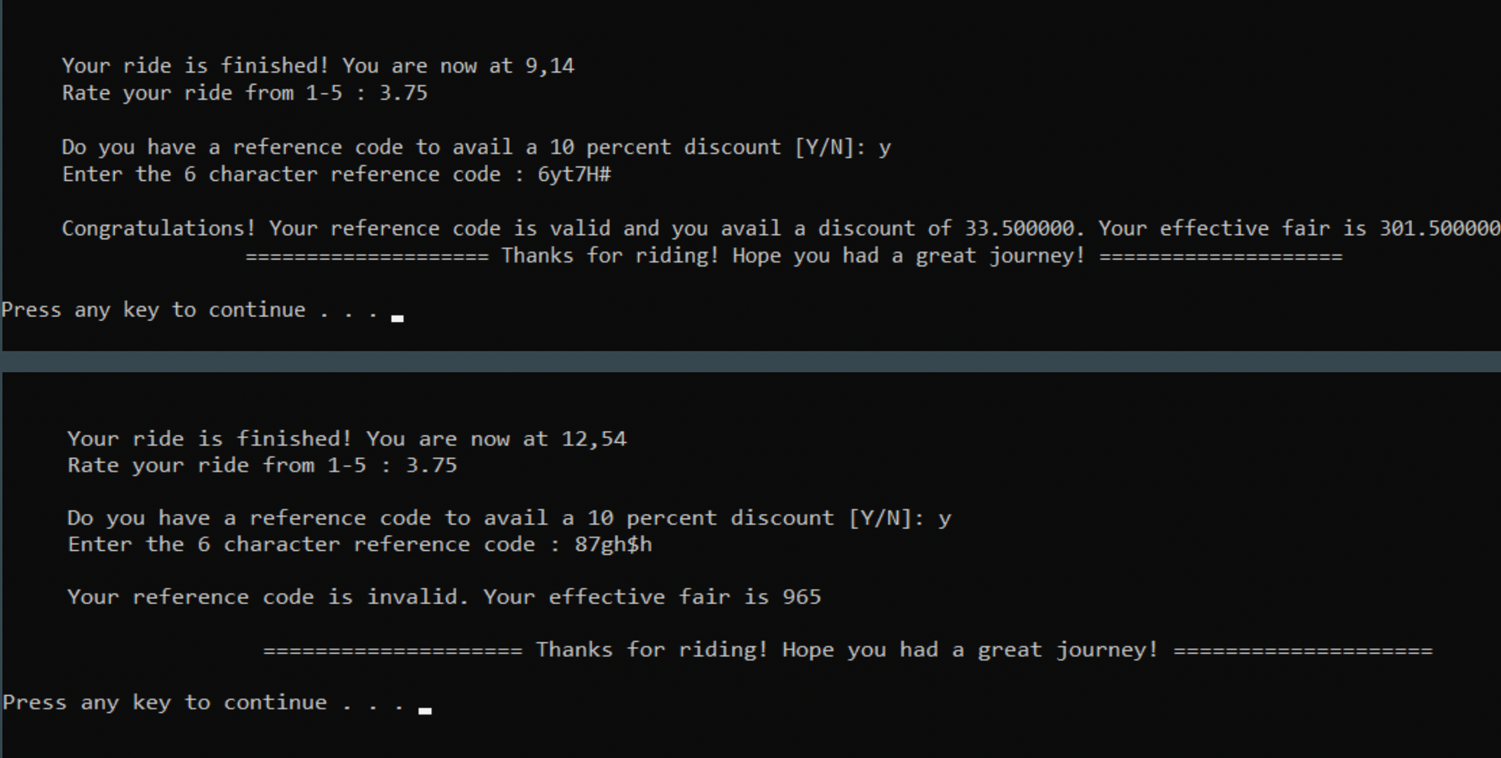
Rate the ride and check validity of reference code

Slide 13
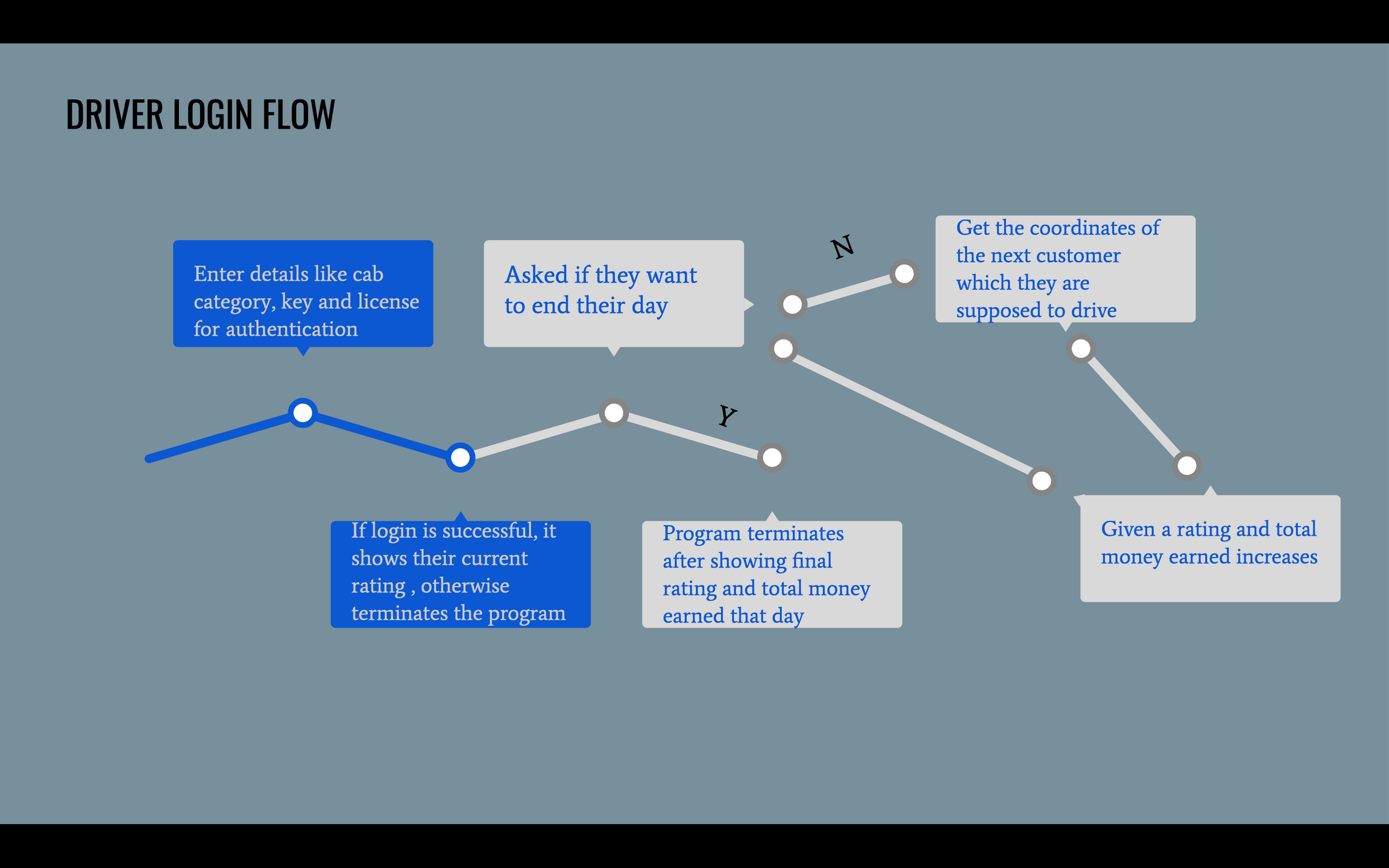

Slide 14
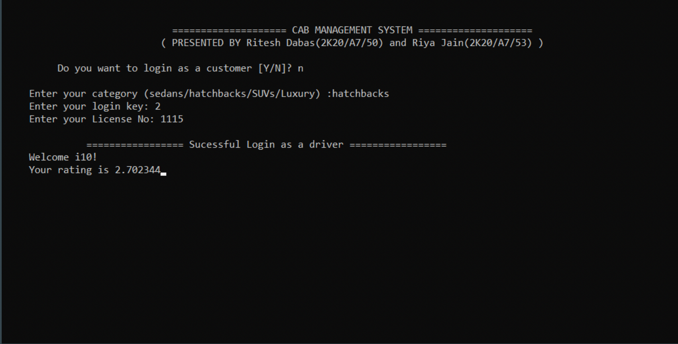
Logged in as a driver and successful authentication

Slide 15
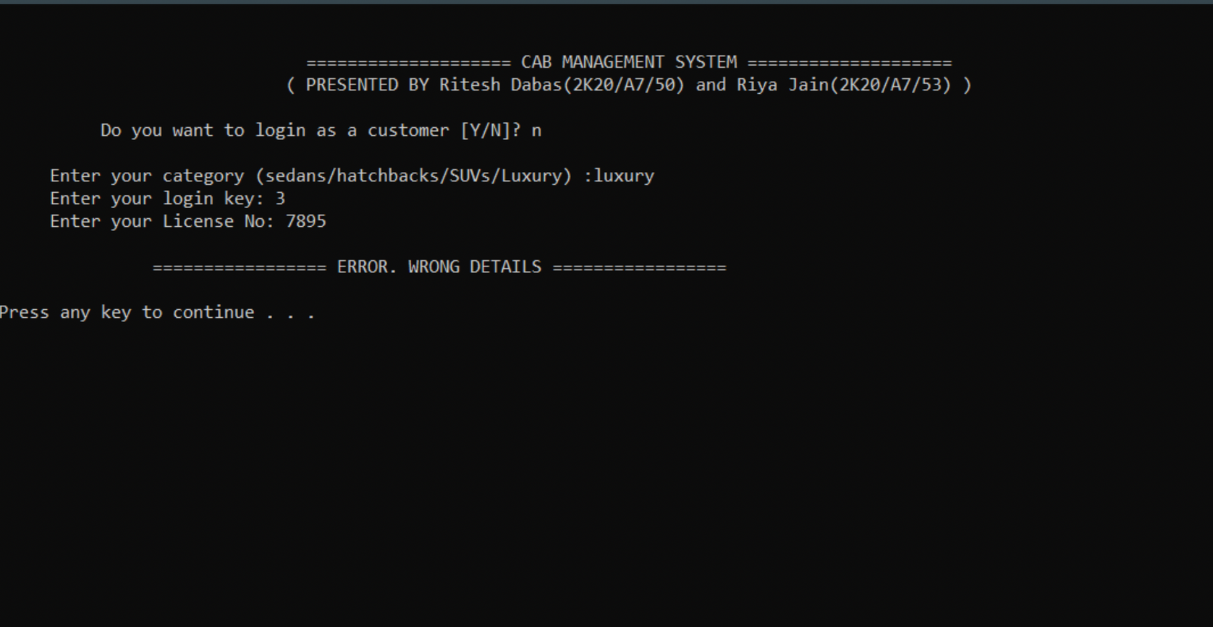
Logged in as a driver and failed authentication

Slide 16
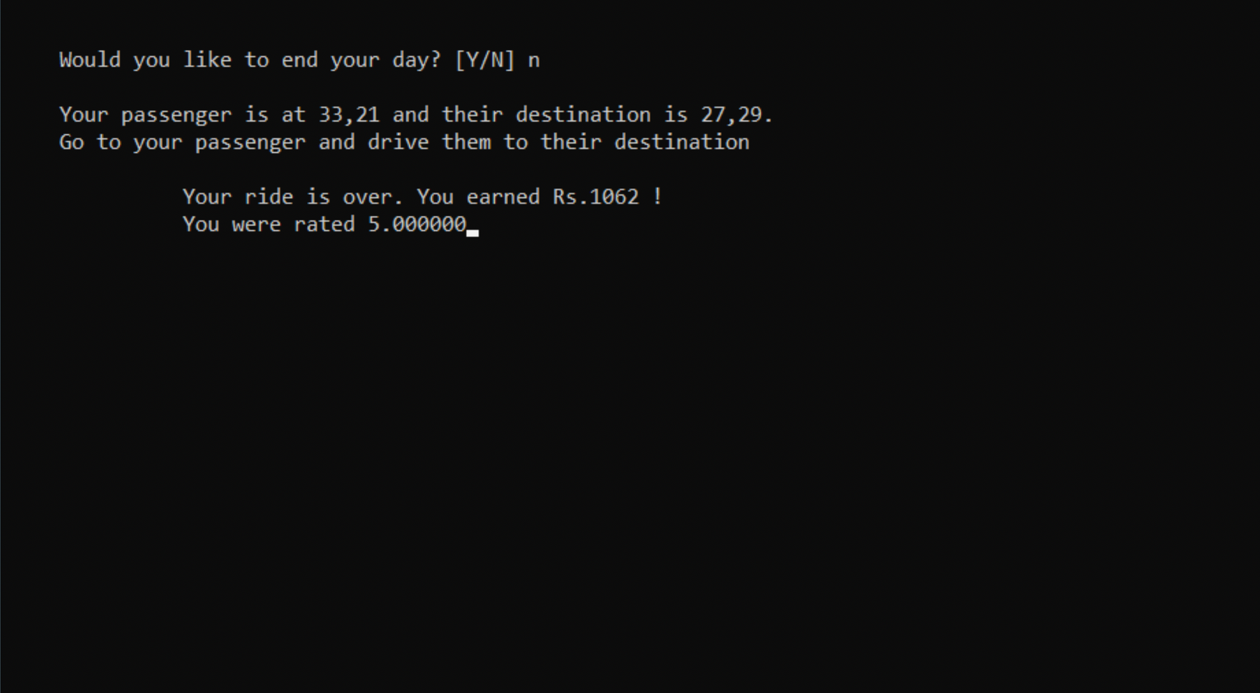
If you choose not to end your day

Slide 17
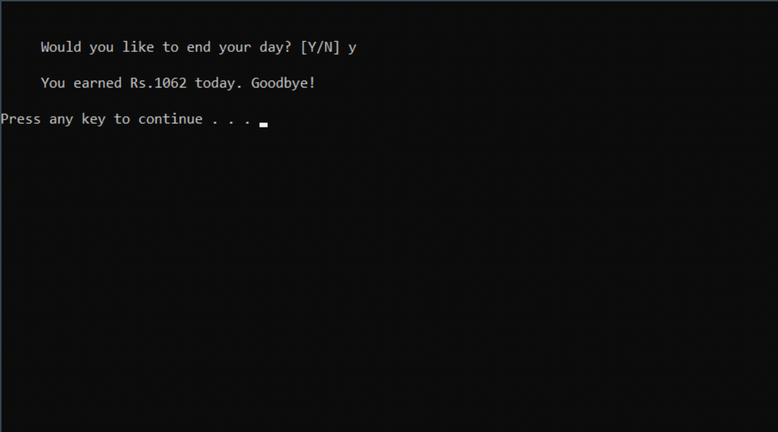
If you choose to end your day

Slide 18
Limitations
01
Interlinking of the user-interface for customers and drivers is not present
It doesn’t store the data for the customers and the credentials have to be entered every time
02
03
Linking our code with some sort of global mapping is not there, hence it is assumed that the cars move in a straight line
04
Some part of the code being hard -coded, expansion would be really difficult
05
User interface could be seen as dull by some users

Slide 19
It can be developed into a GUI to make the system easier and more approachable
Future
Aspects
01
It can be expanded to include more vehicles other than cars
02
03
Use discounts and offer for continuous users
04
Use a database to store the information of customers and drivers
05
And of course, finding out solution for each limitation mentioned in the previous slide

Slide 20
References
01
Let Us C
02
GeeksForGeeks
03
StackOverflow
04
Quora
05
Our friends who had done project on Cab Management System in the past

Slide 21
Thank
You!

